Slide 1
Organizational Impact
Preliminary Framework for Fiscal Sponsors
Thaddeus Squire, Chief Commons Steward
thaddeus@socialimpactcommons.org
Asta Petkeviciute, Chief Financial Steward
asta@socialimpactcommons.org
This work is licensed under a Creative Commons Attribution-NonCommercial-ShareAlike 4.0 International Public License
This means you can adapt this work and share its contents freely for non-commercial purposes, provided you credit Social Impact Commons.

Slide 2
Why Impact?
Advocacy: There is a tremendous need/opportunity to make the case of fiscal sponsorship for the nonprofit sector as a whole, funders, donors, and policy/law makers to encourage more practice of fiscal sponsorship and motivate greater direct investment in fiscal sponsorship capacity.
Benchmarking: Fiscal sponsors thirst for comparative or field-wide data in order to compare performance and impact and place their work in the context of the field.
Organizational Assessment: Finally, aside from comparative analysis of performance, fiscal sponsors could use this data to support internal planning and individual theory of change development work.

Slide 3
Why Now?
Increasing Operational Stress and Financial Volatility: The economy is heading into recession and will continue to be volatile as threats against civil society mount at home and abroad. Many organizations are heading toward the “Covid Cliff”.
Unsustainable Growth: As governmental dysfunction and challenges to social justice continue to mount, the need for refuge and social justice/benefit work grows. This is leading to an unsustainable growth in the sector relative to the flow of funding.
Urgent Need for Capacity Investment in the Field: To address the above challenges, we need more direct investment in fiscal sponsors’ capacity, and for that, a stronger and more urgent case needs to be made to the philanthropic community.

Slide 4
Audiences
Funders: Despite rising awareness and knowledge of fiscal sponsorship among institutional funders, including government, there is a great deal of education and advocacy still to achieve.
Fiscal Sponsors: Whether established or aspiring, we hope this data will help fiscal sponsors achieve a sense of bearing and orientation among peers.
Nonprofit Leaders: If fiscal sponsorship wishes to grow as a field, it needs to build greater awareness among nonprofit leaders (management, governance, entrepreneurs, etc.) and convince them of the potential benefits of shared capacity and infrastructure.
Policymakers & Regulators: Lastly, there are government policymakers, regulators, and sector watchdog organizations (such as Charity Navigator and CANDID) who need more data on the field.

Slide 5
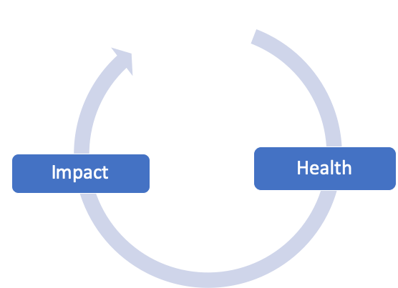
Health vs. Impact
Organizational health and impact are two sides of the same coin. They should reinforce each other in a virtuous cycle.
Health answers a range of questions related to, “How much are we doing, and how well are we operating?”
Impact answers a range of questions relate to, “Are the projects better off?”

Slide 6
Different Dimensions of Impact
There are two dimensions to impact - “snapshot” and “longitudinal”. Both are likely necessary to provide a full picture.
There is also representative impact (what activity do you house?) and direct impact (what do you do for projects?). Representative impact includes:
Number and demography of projects housed
Economic impact of program: total spend, payroll, tax roll
Number of hours of service, transactions managed, etc.

Slide 7
Direct Impact Assessment General Assumptions
Organizational impact for a fiscal sponsor as most coherently assessed in the relationship between sponsor and sponsee.
The impacts your projects/partners have on their beneficiaries are too diverse to consolidated into a unified theory of change or impact model, unless you as a sponsor are focused on a specific field/impact model.
To demonstrate compelling impact, we need to focus more on causal not correlative relationships in the sponsor-sponsee relationship, alongside qualitative feedback from sponsees.
You can only begin to assess direct impact if you have clear/equitable services, level of effort tracking, and other frameworks and trackable data.

Slide 8
Direct Impact Assessment Challenges
Who owns impact? Establishing distinct agency (cause) between sponsor and project for impacts both on the project and its beneficiaries is challenging for sponsors, as sponsors are integrated capacity for projects.
As compared to what? Demonstrating things like efficiency and effectiveness imply some manner of comparative benchmark. Standards and models for overhead range widely.
How do we determine causality? Organizations, in particular sponsors, are complex systems embedded in even more complex systems. Isolating a particular cause and effect to demonstrate impact is difficult or impossible.

Slide 9
Hypotheses Frameworks
The impact of a fiscal sponsor on its projects is directly related to…
1. Project Success: The achievement of the unique goals or theory of change/impact held by the project: “90% of our projects achieved their stated goals for the year.”
Strength
– It’s what everybody wants to know: the bottom line.
Considerations
– Ownership of impact and causality is hard to parse.
– Assumes every project has goals/TOC and progress can be tracked across all projects
2. Operational Efficiency/Effectiveness: The level of cost savings, capacity adds, access, that projects enjoy under a sponsor:
Strength
– Powerful datapoint for funders/donors/boards
Considerations
– Ownership of impact and causality is hard to parse; issues with benchmarking
– Beyond tracking transactional supports, other support can be hard to quantify

Slide 10
Hypotheses Frameworks Cont.
The impact of a fiscal sponsor on its project is directly related to…
3. Project Satisfaction: The providing of responsive and effective back office and other support: “90% of our projects reported high customer satisfaction.”
Strength
– Demonstrates perceived value on behalf of project
Considerations
– Subjectivity/qualitative data is an issue here; likely requires a 360-degree approach
4. Project Team Well-being: The level of well-being experienced by project teams: “90% of our projects reported high levels of well-being and sense of being supported.”
Strength
– Demonstrates the health of the team doing the social benefit work
Considerations
– Subjectivity/qualitative data is an issue here
– Requires vetted individual assessments for all project team members

Slide 11
Thaddeus Squire, Chief Commons Steward thaddeus@socialimpactcommons.org
215 760 1634
Asta Petkeviciute, Chief Financial Steward
asta@socialimpactcommons.org
617 448 9559
http://socialimpactcommons.org
Generous support for the development and work of Social Impact Commons has been provided by:

