Slide 1
Collective Capacity Building:
Business Models for Shared Resources
Asta Petkeviciute, Chief Financial Steward
asta@socialimpactcommons.org
This work is licensed under a Creative Commons
Attribution-NonCommercial-ShareAlike
4.0 International Public License
This means you can adapt this work and share it’s contents freely for non-commercial purposes, provided you credit Social Impact Commons.

Slide 2
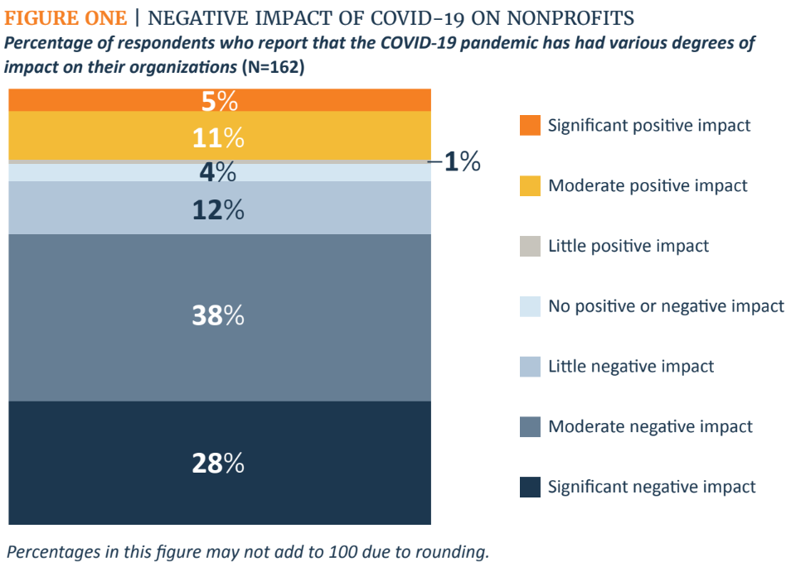
Latest Analysis of Nonprofit Sector:
Almost 70% of all nonprofits were negatively impacted by COVID
https://cep.org/wp-content/uploads/2021/06/CEP_Persevering-through-Crisis_2021.pdf

Slide 3
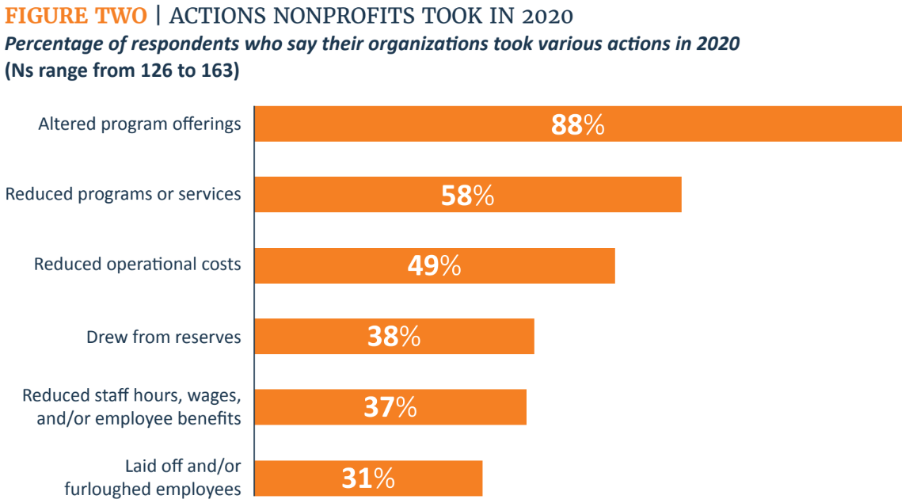
Latest Analysis of Nonprofit Sector:
Reduction – the most common strategy for survival
https://cep.org/wp-content/uploads/2021/06/CEP_Persevering-through-Crisis_2021.pdf

Slide 4
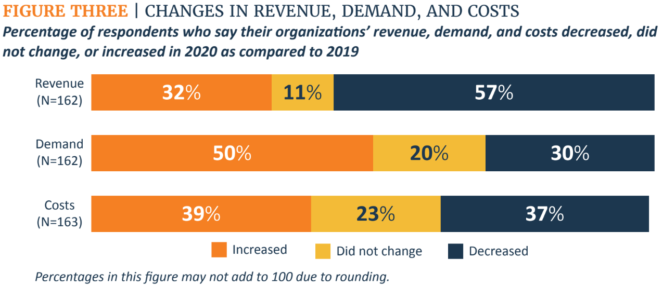
Latest Analysis of Nonprofit Sector:
Increase in demand while revenues and costs decreased
https://cep.org/wp-content/uploads/2021/06/CEP_Persevering-through-Crisis_2021.pdf

Slide 5
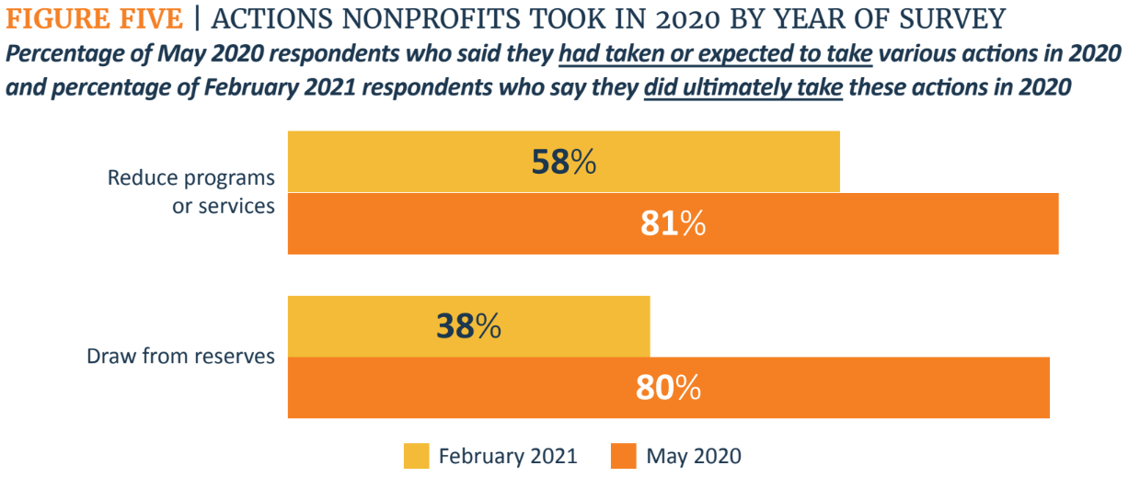
Latest Analysis of Nonprofit Sector:
Reduction in programs was necessary for survival
https://cep.org/wp-content/uploads/2021/06/CEP_Persevering-through-Crisis_2021.pdf

Slide 6
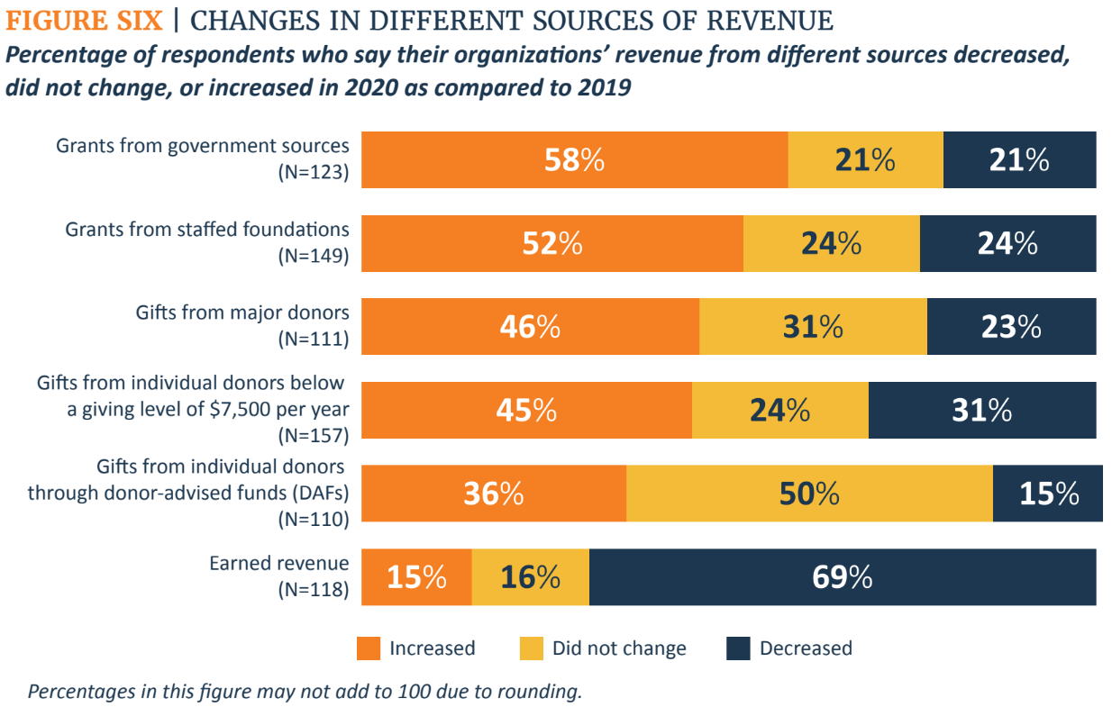
Latest Analysis of Nonprofit Sector:
Are we ready to support the upcoming changes in revenue sources?
https://cep.org/wp-content/uploads/2021/06/CEP_Persevering-through-Crisis_2021.pdf

Slide 7
Commons manager
as a Resource Model
Requires balance, passion, consistent focus and intention!
https://www.cartoonstock.com/directory/b/balanced_portfolio.asp

Slide 8
Commons Manager
Value is created by participants/members paying for a “share” of a material (or “market”) resource, like infrastructure, space, technology, staff, etc.
Constituents pay/allocate “shares” based on scope of need, budget size, or other equitable means for the resources they consume, like a co-op.
Key considerations:
Do we have the capacity to develop and share with other partners sustainable?
Do we (or others) think of us as a resource “hub” for our community?
Is our portfolio balanced?
Are the key risks of running the program addressed?
Are we able to cover the true costs of running the program?
Do we need to fundraise from donors to cover the true costs of delivering the program?
Do we have enough internal assets to complete our obligations for all current net assets?
Do I have necessary resources to meet the intended growth?

Slide 9
Five things to embrace.
Know your portfolio of projects (present and intention for the future).
Know your financial health and where vulnerabilities exist (present or future), whether brought on by COVID-19 or other circumstances.
Know what you’re great at and where you want to go with your work. What size feels right for you and your community?
Be ready to invest time and other resources. Remember that not all change requires financial capital, but every change requires “sweat equity”.
Think about resources broadly (time, relationships, systems, buildings, stuff), not just money. Vision and drive always lead, money follows.

Slide 10
Five things to avoid.
My mission is to support everyone, forever and for as little as possible. Know your market. Focus on the communities that have your trust and whom you could serve the best, and know your costs!
Death by a thousand revenue streams. Focus on one or two key revenue streams but seek diversity and renewability in your sources.
Pressure to scale in the name of “capacity building”. Bigger is not always better. Think about your right size. What is enough?
Thinking you operate in an established market. – There are more than 800K nonprofits operating under $500K/year, and less than 400 self-identified fiscal sponsors.
Being like the other person. Share lessons and ideas from/with your peers, but your solution will have its own contours and attributes.

Slide 11
What tools do you use to manage, track and analyze your FS portfolio?
Portfolio day-to-day management tool
Portfolio analysis and projection tool
Organizational budget and ongoing financial reporting
Financial analysis for similar nonprofits in the community
Other external reports for nonprofits at large

Slide 12
What do you know about the market?
The space between gray and orange = overhead savings!
Arts and culture organizations operating below $2M spend between 17% and 27% of their revenues on the same resources that a comprehensive fiscal sponsor can provide for between 9% and 12%: a “savings” of about 10%!*
If just 10% of PA arts organizations were fiscally sponsored, they could reallocate about $5.3M to direct programs and services!
G&A as %
of Revenue
Budget Size
Budget Bracket
Source: (*) Research on 475 Pennsylvania cultural organizations with budgets less than $2M completed in 2019 by Social Impact Commons in partnership with Accenture and SMU Data Arts, publication forthcoming.

Slide 13
Thaddeus Squire, Chief Commons Steward thaddeus@socialimpactcommons.org
215 760 1634
Asta Petkeviciute, Chief Financial Steward
asta@socialimpactcommons.org
617 448 9559
http://socialimpactcommons.org
Generous support for the development and work of Social Impact Commons has been provided by:
and

